Slide 1
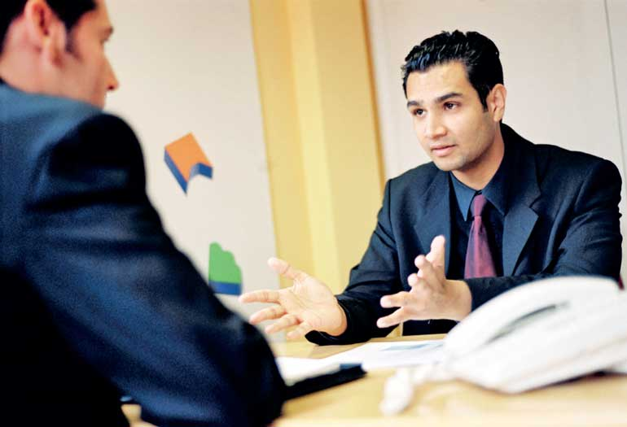
Interview skills

Slide 2
By the end of this session, you will be able to
appraise the role of effective verbal and non-verbal communication in job-interviews
use a range of verbal and non-verbal communication strategies to face a job interview successfully

Slide 3
“Job interviews are scary, even when you’ve prepared thoroughly. But when you are prepared, you can harness the adrenaline to work for you so that you put your best foot forward and get the job you want.”
(Locker & Kaczmarek, 2007: 499. Business Communication: Building Critical Skills. Boston: McGraw Hill)

Slide 4
Job interviews
A job interview is a conversation between an job applicant and a representative of the organization that is looking forward to hiring the interviewee. Everyone involved in a job interview has a common purpose, i.e. getting information and evidence.
The interviewer wants to know about your competencies, skills, knowledge and experience. They need to find out whether you are the best match for their job. An you are want to know about the job, the colleagues, the terms and conditions, the working environment - to see if the job matches your expectations and needs.

Slide 5
The best interview strategy
The best interview strategy is the one you develop for your yourself by answering the following questions:
What do I want the interviewer to know about myself?
What disadvantages or weaknesses do I want to minimize?
What do I need to know about this job or this organization?

Slide 6
The role of effective communication
The way you conduct yourself and responds to questions at an interview also gives information and evidence about your attitude, style and the impact you make on others. Therefore, communication skills are essential for success at a job interview.
The communication skills used at job interviews include
• non-verbal communication
• listening
• responding
• questioning

Slide 7
Choose the best answer.
Mutual understanding is mainly established and maintained
a) non-verbal communication
b) verbal communication

Slide 8
The role of non-verbal communication
Effective communication is mainly established and maintained by non-verbal cues.
7% of what we say is communicated by our words.
38% of what we say is communicated by our tone of voice
55% of our message we say is communicated by our body language.
Therefore, 93% of face-to-face communication is via non-verbal channels.

Slide 9
Know the job and the company well. Some prior research would help.
Respond to topic shift.
Use industry terms and technical jargon
Use specifics and examples
Ask questions where appropriate.
Speak more than interviewer/s.

Slide 10
Communication
Learn and practice how to smile and greet.
Maintain positive and comfortable eye contact
Sit firmly and straight on your chair.
Don’t show your nervousness.
Pick up on interviewer’s cues.
Show your enthusiasm.

Slide 11
Unsuccessful Candidates
Had vague ideas
Rarely used company name
Didn’t know about the company
Responded in neutral tone
Made little eye contact
Resisted shift of topic
Didn’t use jargon
Gave short answers
Asked few questions

Slide 12
Successful Candidates
Were specific and consistent about position.
Used the company name.
Showed research about company
Responded positively to information
Made eye contact often, SMILED
Accepted topic shift
Used technical jargon
Asked questions
Answered with specifics, supported claims
Spoke more than interviewer/s

Slide 13
Active listening
Listening is one of the most important skills you can have. How well you listen has a major impact on your success at the interview, and on the quality of your relationships with others. The top tips for active listening are:
a) Pay attention.
b) Show that you are listening.
c) Seek clarification if you don’t understand.
d) Deter judgment.
e) Respond appropriately.

Slide 14
6 C’s of Effective Communication.
Clear: Ensure that information is presented clearly.
Concise: Do not lose the message by being long-winded.
Correct: Avoid giving misleading information.
Complete: Give all the necessary information and not just part of it.
Concrete: Give examples and stories rather than talking about things in general.
Courteous: Always be and sound polite.
Confident: Demonstrate a confident tone and a ‘can do’ attitude.

Slide 15
Language support
Describing your personality: adjectives
Describing your strengths: present tenses
Describing your education and experience : past simple and present perfect
Describing your future goals
Solving common pronunciation problems
Structuring your answers

Slide 16
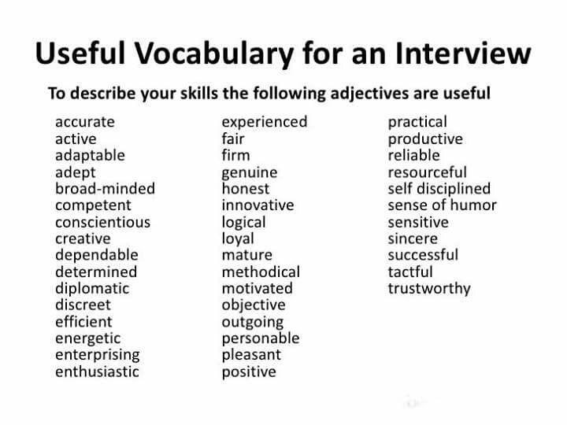
Describing your personality

Slide 17
Describing your strengths
I’m good at meeting deadlines.
I’m skilled at working under pressure/working to a deadline.
My main strength is my ability to communicate effectively. I am a near-native speaker of English.
My strengths include my ability to problem solve/be enthusiastic/speak fluent English, etc.
I have a flair for…
I am passionate about…

Slide 18
Describing your education
I have a degree/diploma in journalism.
I have completed a degree/diploma in Geography.
I have studied graphic design up to diploma level.
I have successfully completed the strategic level of…
I recently graduated from the University of Kelaniya with a degree in Marketing.

Slide 19
Describing your work experience
I have five years’ of experience as a….
I (have) worked in the retail industry for….
From 2013 to 2016, I worked as../I was employed at..
At university, I volunteered as a…

Slide 20
Describing your future goals
I’m looking to further my skills as an accountant/in hospitality, as a childcare worker/in training and development
I’m want to further my career in physiotherapy/as a physiotherapist, in administration/as an administrator, in retail/as a branch manager
I feel my skills set is a perfect fit for your team and I can contribute by…

Slide 21
To give your opinion…
In my opinion…
As far as I am concerned…
To my mind…
From my point of view
To the best of my knowledge
I strongly/firmly believe that…
It seems to me that…

Slide 22
Interview Structure
Introduction
Evidence-speaking
Your questions
Closure

Slide 23
Structure each of your answers
S | Give brief details of the situation.
T | Say what you wanted to achieve – your target
A | Say what you did – your actions
R | Say what the result was.
And remember to signpost your evidence:
OK. I’m going to tell you about the time when I …… my goal was as follows ….to achieve this objectives I did three things…... As a result of my actions..

Slide 24
Question: Tell us about a challenge you’ve faced and how you handled it
Possible answer:
In my last job, we were facing a tough deadline and my boss was out for the day. Our client was expecting a project to be delivered by 5PM, but we were far behind schedule. I took the lead on the project, delegated tasks to the four other team members in a way that I thought would utilize everyone’s strengths best. And then I re-organized my own personal tasks so I could dedicate my entire day to contributing to this project as well. The project was a success and we delivered the work on-time. I went on to lead more projects after that, and used what I learned to be a better project manager.”

Slide 25
Other interview details
What to wear
What to take
What to note down
How to get there

Slide 26
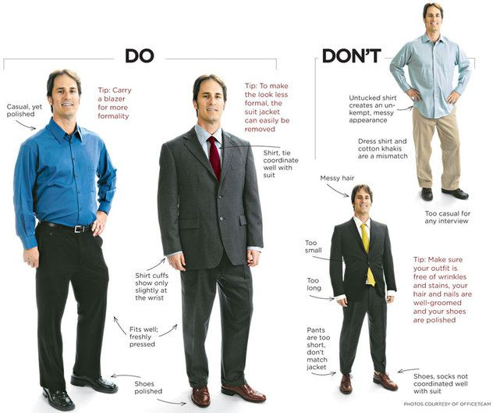
Attire

Slide 27
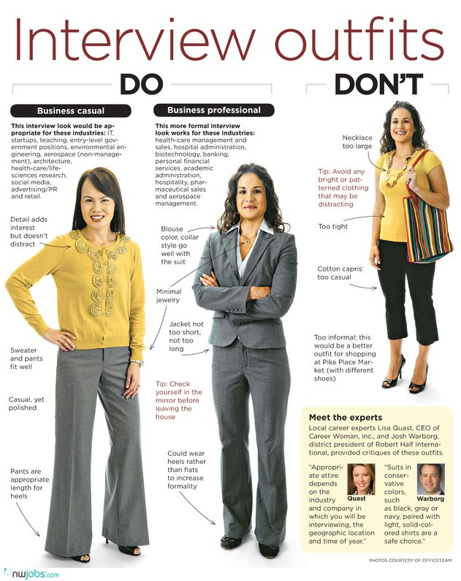

Slide 28
Mock interviews

